Slide 1
Smart Energy Grid Failure Management
IOT Project Team-2

Slide 2
MOTIVATION
Energy grids are critical for infrastructure that supplies power to homes, business, and industries.
However, they are susceptible to various failures, leading to power outages.
The smart grid represents an opportunity to move the energy industry to a new era of reliability, availability and efficiency by:
Quick restoration of power after disturbances.
Reduced operations and management costs.
Improved security.
Quick redirection to critical infrastructure for its smooth functioning.

Slide 3
PROBLEM STATEMENT
The project should present an automated and efficient energy grid that can manage various failure scenarios.
Predictive load assigning based on (manually assigned) priorities of appliances.
UI for viewing status of the grid ( device health status, total and individual power drawn, etc.) as well as controlling aspects of grid like connecting and disconnecting devices.
Visualisation and graphs of power consumption over time.

Slide 4
Sensors and Actuators used
Sensors:
ACS712 Current Sensors
DHT11 Temperature Sensors (not used in final evals but were used in mid evals)
Actuators:
Electromagnetic Relays and Relay Modules
Potentiometers
Motor Drivers
Motors (as appliances)
LEDs (as appliances)

Slide 5
Project Features
Using Relays for switches to control current flow.
Potentiometers are used to distribute load based on user defined priorities.
Current sensors are used to measure and collect data of current in the circuit.
DC motors and LEDs are used for appliances in the grid.
Selecting priorities for load distribution.

Slide 6
Project Features
Monitoring and Controlling of grid through remote web based UI.
Usage of OM2M for Middleware and ThingSpeak for data collection/Visualization.
ThingSpeak visualizations of current through different appliances in grid over time.
Monitoring & control of current through various parts of grid using information/Alerts given by web server.

Slide 7
Project Features
Load Distribution using data from current sensors and computation of edge.
Setting priorities by individual user for their devices.
Power disconnect detection.
Theft Detection System.

Slide 8
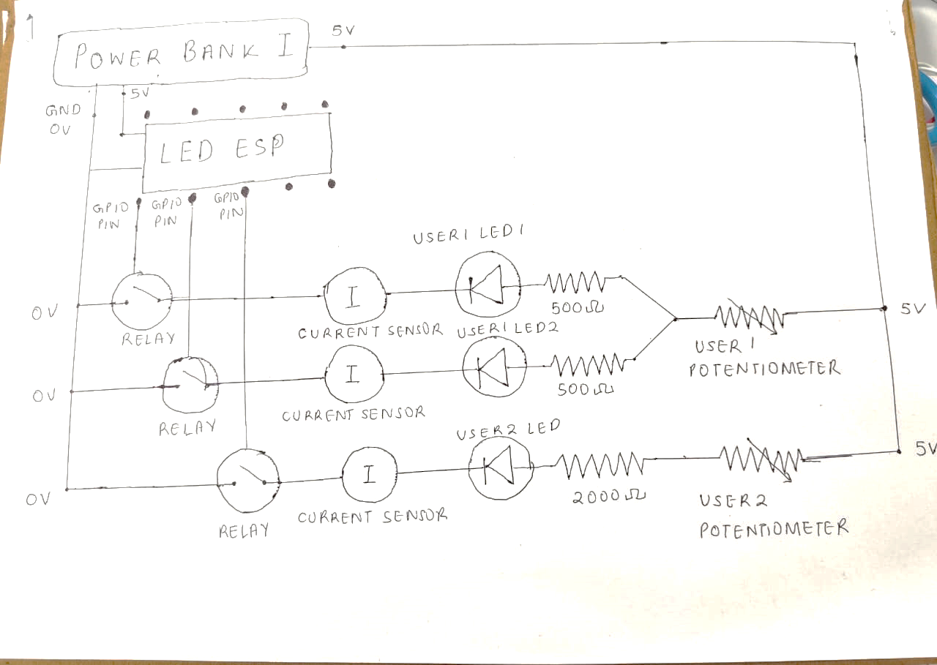
Circuit diagram

Slide 9
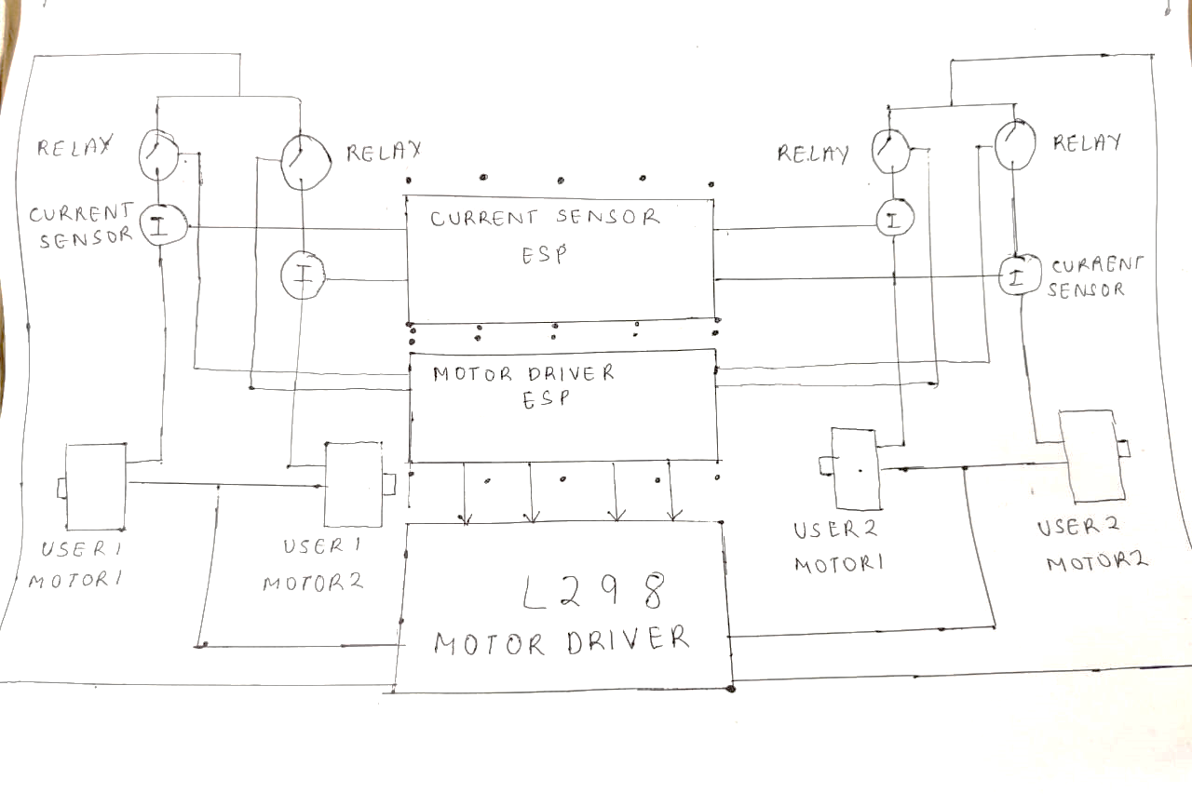
Circuit diagram

Slide 10

Load distribution
Load management is main concern of Smart Energy Grid. The user can get notified and allow automated actuations for more simplicity.
Whenever the current supplied to devices are more or less than respective thresholds, the grid gives an alert to alter the resistance of respective Potentiometers connected to the devices.
This is based on Edge computing, as the checks are made at the microcontroller level, and alerts are sent to the cloud.

Slide 11
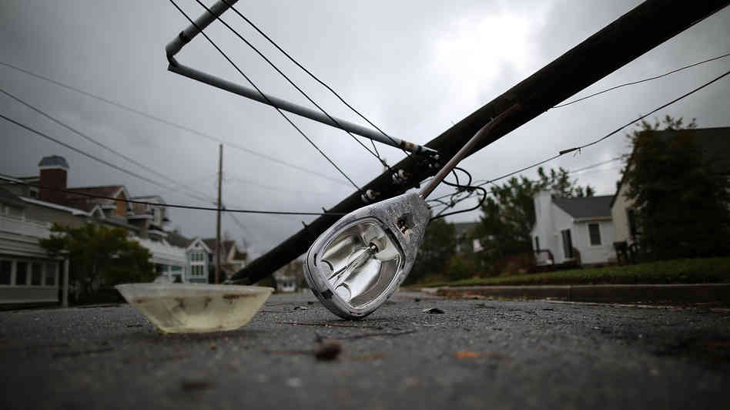
Power disconnect detection
Grid can detect disruption/cable cuts in the circuit and Alert the User.
Uses Edge-based computing to detect damage.

Slide 12

Theft detection
Our grid can detect unauthorized current withdrawal at any point on the grid.
Gives Alerts to the user.
Also uses Edge-based computing to detect theft.

Slide 13
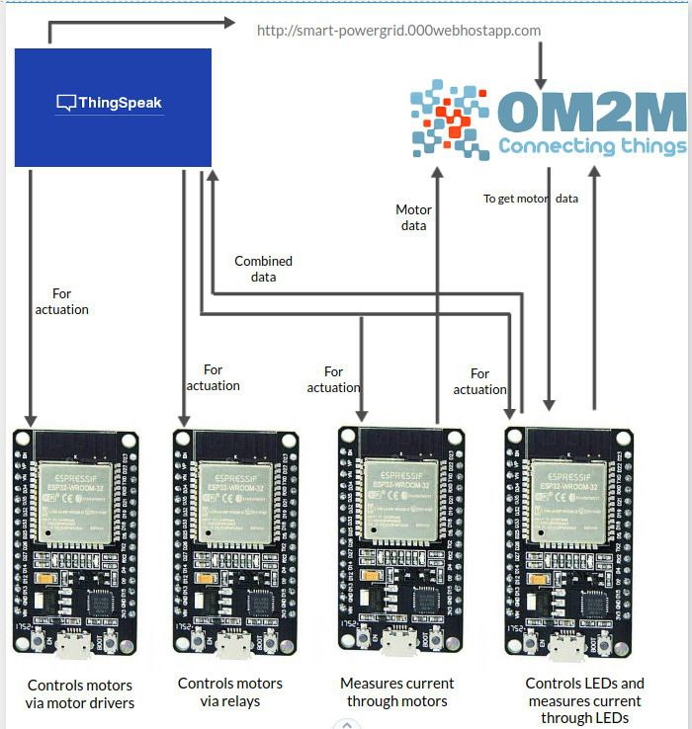
Data flow
http://smart-powergrid.000webhostapp.com is the website for user-friendly UI to display data of devices and control them.
ThingSpeak is used for visualisations of data and actuation.
OM2M is used as Middleware.

Slide 14
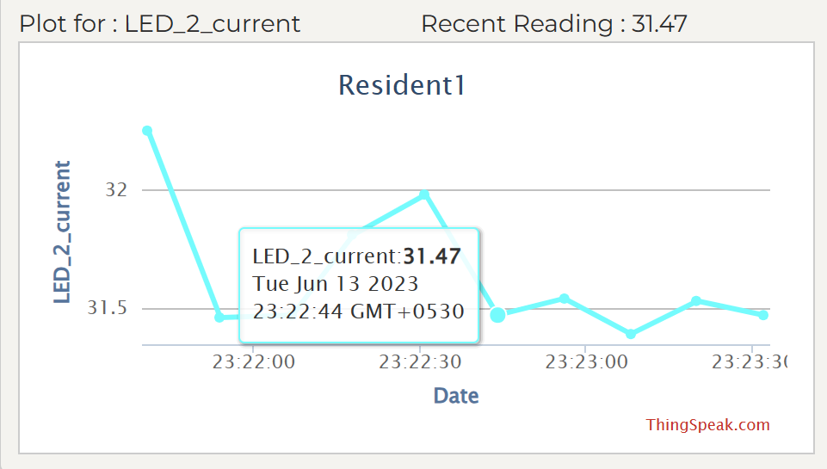
Data visualisation
Collects data and graphs are visualized representing variations of data with time.
Data is taken up for analysis from these visualizations.

Slide 15
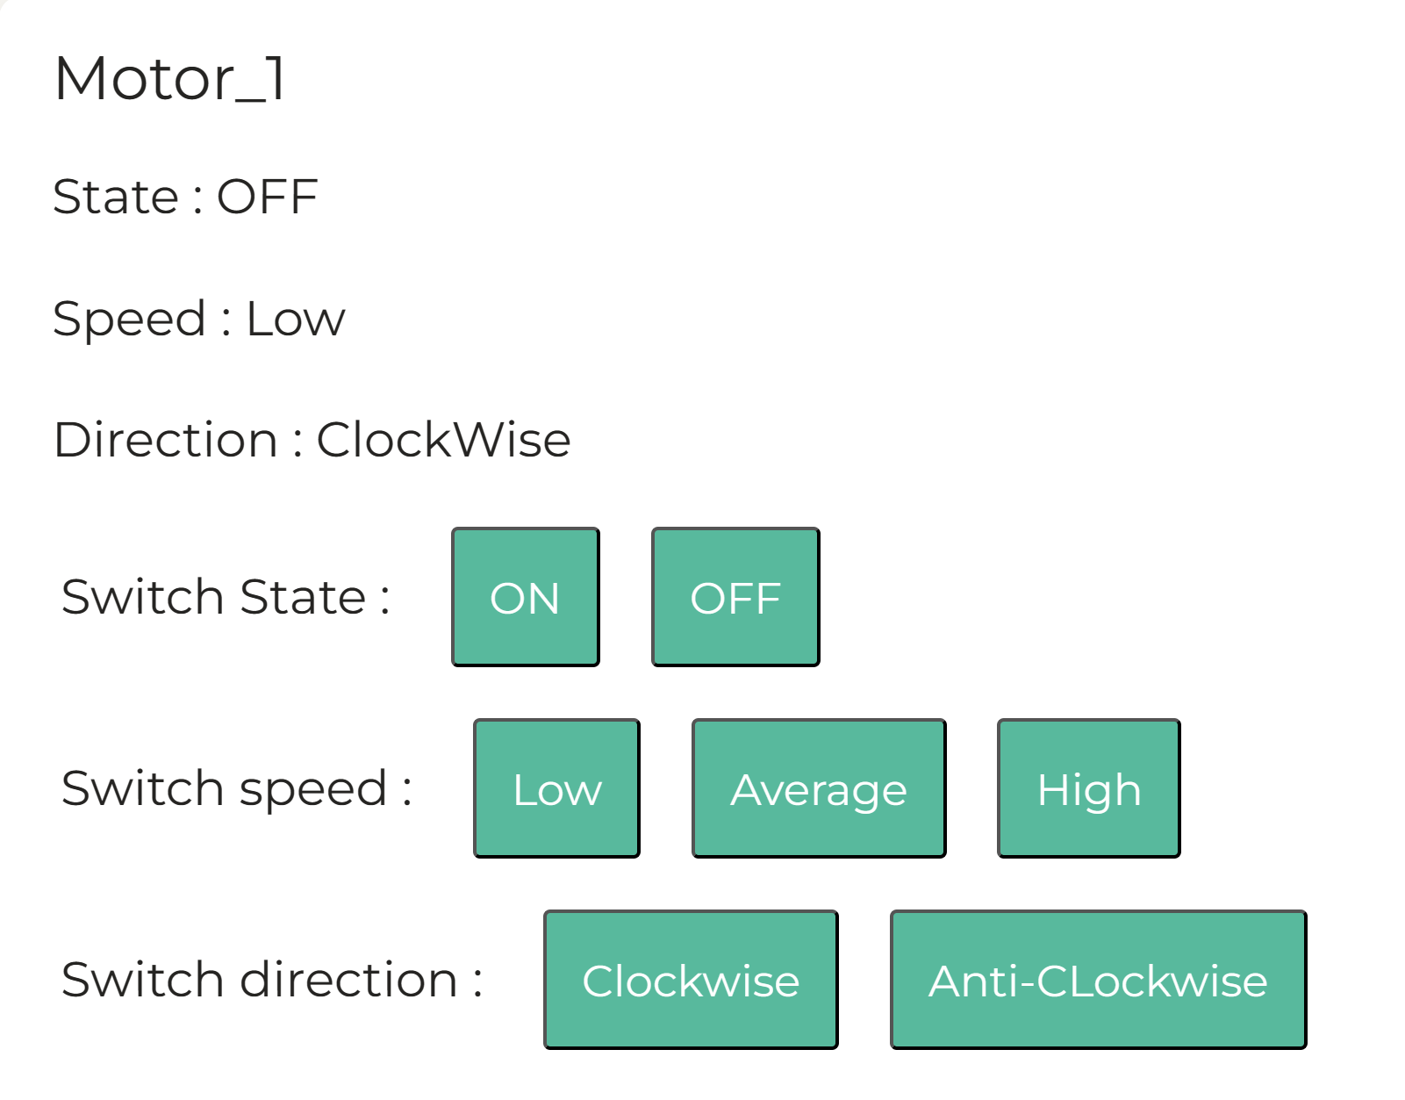
Ui based actuation
Users can control every device remotely using UI very conveniently.
Can check for status of devices.

Slide 16
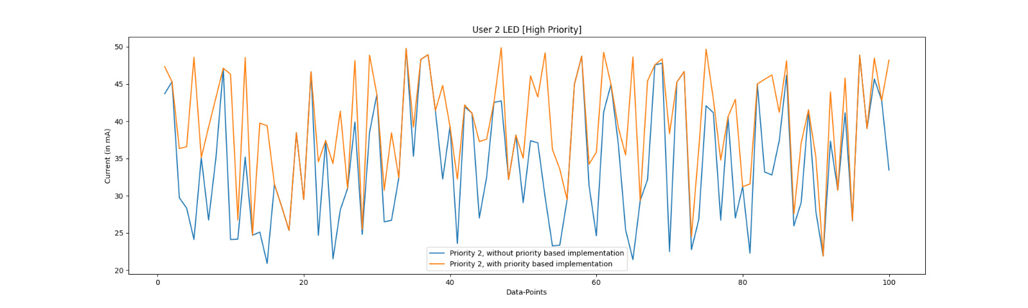
Data collection

Slide 17
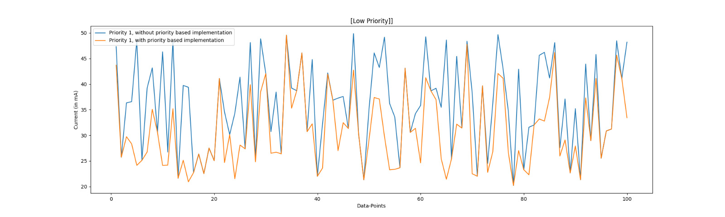
Data collection

Slide 18
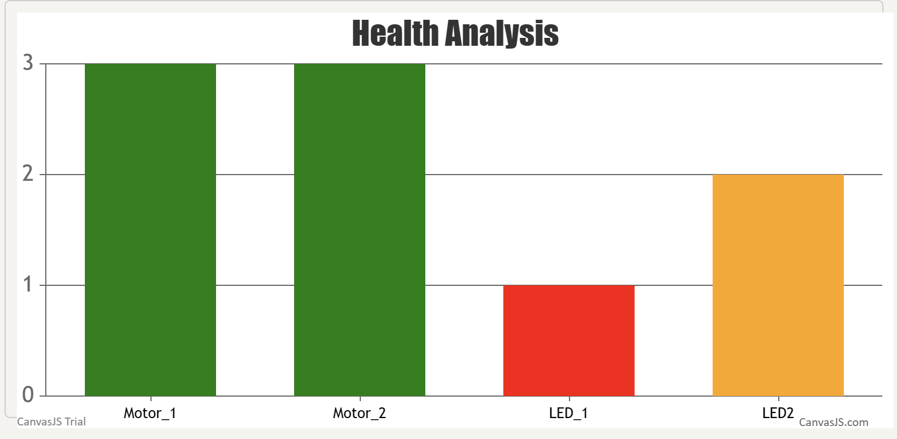
Data Analytics
Analysis of Data collected and Health for each device is calculated using the fact that the resistance increases as the appliance degrades, leading to a reduction in current.
Using the fact R=V/I, relative change in resistance is
If this lies between 0% and 5% health is Good, and if it lies between 5% and 10%, health is decreased to OK and if it exceeds 10%, health is decreased to critical.

Slide 19
Future Scope of thE project
Automated load distribution using digital potentiometer using data from web server.
Backup power supply during outages (batteries, renewable source of energy, etc).
Rerouting the supply based on path in which energy losses are minimum(using Dijkstra algorithm) and to keep circuit closed.
Include more appliances to the grid and to record their patterns of power consumption.
Scheduled power cuts for maintenance.
Monitoring temperatures of devices to judge their health and give Alerts during power surges/overheating.

Slide 20
CONTRIBUTIONS TO PROJECT
Current Sensors – Ishan
Motors – Samyak
Relays – Faisal, Sujal
UI/ThingSpeak/OM2M –Dileep, Asish, Karthikeya
Load Distribution– Swaroop, Asish, Jayanth
Health Monitoring- Ishan
Circuit Design – Samyak, Faisal, Sujal, Harshul
Temperature sensor - Gadha
Data Analysis- Asish

Slide 21
tEam Members
Dileepkumar Adari (2022101007)
Swaroop C (2022101114)
Asish Chodavarapu (2022101100)
Harshul Dondeti (2020101112)
Mohammed Faisal (2022101101)
Ishan Gupta (2022111007)
Jayanth Kandi (2022101038)
Sujal Keshri (2022101004)
Samyak Mishra (2022101121)
Chaganti Venkata Karthikeya (2022101058)
Gadha Warrier (2022101107)

Slide 22
THANK YOU!

